Slide 1
PYTOTUBE: DUAL PHSYICS SOLVER FROM SCRATCH
With (Scientific) Python Language

Slide 2
Why Python?
Extremely powerful
Numerical Computation (numpy)
Visualizing
Parallel processing (including CUDA, and OpenCL)
Image processing
GUI development
Interactive Computing lik (and better than) MATLAB with IPython.
Notes:
Python is developer friendly and easy and also powerful language for scientific computation.
Portable: runs all OS
Modern: Object oriented, Interactive computing like MATLAB, GUI Development, coding standards makes highly readable code writing.

Slide 3
Why Python?
It is developer (scientist) friendly BECAUSE:
You feel very comfortable as developing it MATLAB.
Interpreted, NOT compiled. You don’t need to compile and link. Just code and run. Developing an extremely computationally intensive programs is better in Assembly but DO NOT worry because Python is a powerful glue language to integrate extensions written in other languages.
Portable (Runs both Windows and Linux without pain.
Modern
Object oriented
Well-suited to modern-day application (unit testing, GUI development, readable coding, OOP, etc.)

Slide 4
APPLICATION DESIGN
And planning according to future plans

Slide 5
Programming Requirements
Reusable : Modular
So any application can use a part of code
Easy Extensible for Multi Physics : Object oriented
Solver algorithms/Mesh types/Any Physics must be added dynamically, seamless and painless.
Well documented
Version Control System : Git
Source Version Control System is a MUST of software development process.
Notes:
Since we are being developing a dual (and multi) physics software it MUST be
Highly Modular and easy extensible,
Object Oriented design makes software a little bit slow, but it is needed for complicated software, and it makes easy thinking of app design

Slide 6
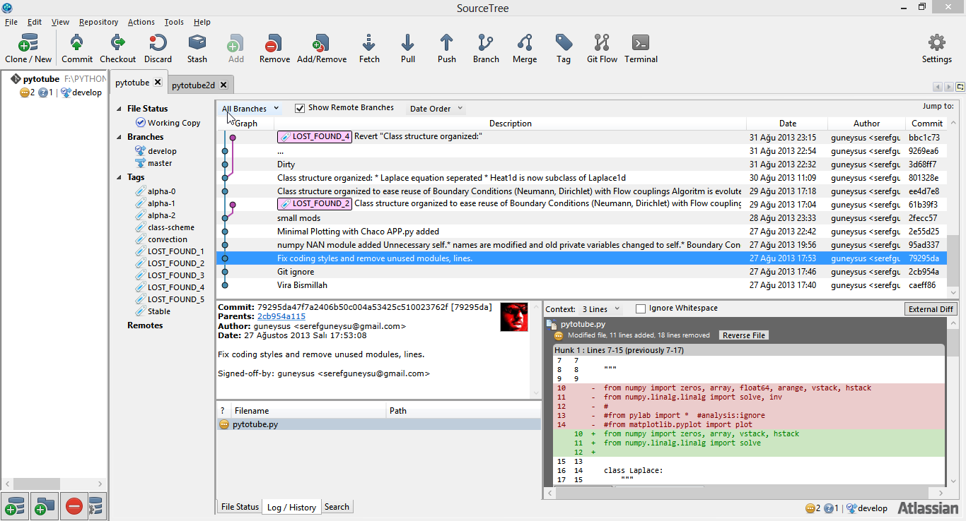
Version Control GUI for Git

Slide 7
Short Term Scientific Requirements
2D Transient Laplace Solver for Velocity and Temperature Fields
Dual physics (Heat and Flow) and Free/Forced Convection in 2D
Simple Optimizations
Polar / Cylindrical Coordinates Support
Simple Radiation modelling
Essential heat and flow boundary-initial conditions modelling
Simple couplings
Sparse matrices for performance

Slide 8
Long Term Requirements
Geometry/Mesh import from common formats (Paraview, Fluent, Gridgen)
Automatic meshing with Netgen Lib
Switching from Finite Differences to Finite Elements.
Extensive Radiation modelling
Advanced boundary-initial condition input. (polynomial, function, etc)
Turbulent modelling
Topology optimization

Slide 9
Finite Element Scheme
Node based approach, finite differences method with node based scheme.
In Laplace2d class, energy approach is used with cell based scheme. Cell based means that one temperature represents a cell.
T(i)
T(i+1)
1D node based approach
T(i,j)
T(i, j+1)
2D cell based approach

Slide 10
Application Design
Classes must separated with the respect of scientific branches.
Fluid mechanics / Math / Heat Transfer
Don’t repeat yourself law.
For the maintainability and reusability.
class Heat1d(Laplace):
Heat1d is inherited from Laplace class, means Heat1d class owns all properties of Laplace class. Laplace class designed/planned as it would be used as any Partial Differential Equation in the form of Laplacian Equation.

Slide 11
Matrice Solving Method
At now, we are not considering performance issues. So We solve the matrices by
solve(A,B) or inv(A)*B

Slide 12

Which Boundary Conditions Implemented in Laplace Eqn.?
Steady State Laplace Equation
$$\frac{∂^{2}φ}{∂ x^{2}}+\frac{∂^{2}φ}{∂ y^{2}}=0$$

Slide 13
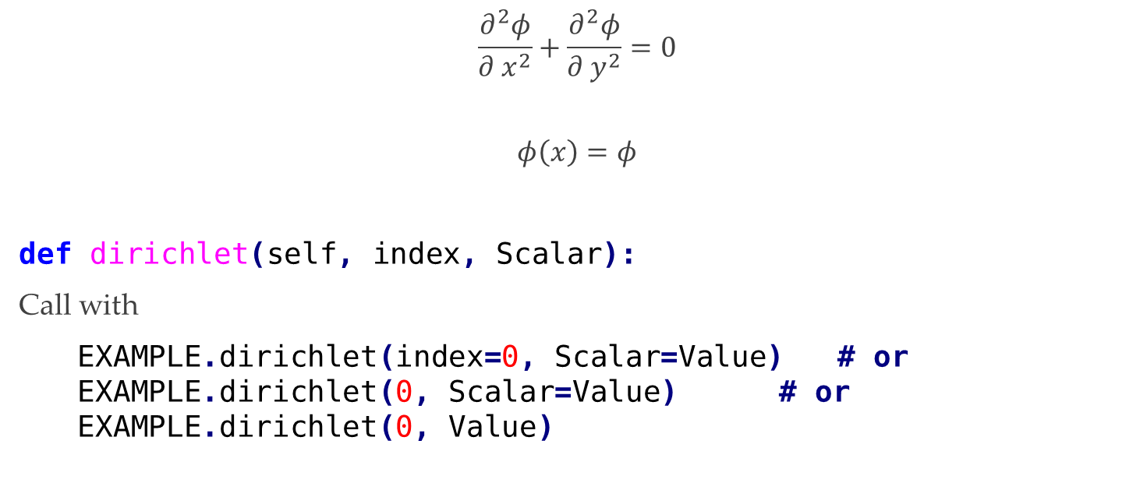
Dirichlet BC
$$\frac{∂^{2}φ}{∂ x^{2}}+\frac{∂^{2}φ}{∂ y^{2}}=0$$
$$φ\left(x\right)=φ$$
def dirichlet(self, index, Scalar):
Call with
EXAMPLE.dirichlet(index=0, Scalar=Value) # or EXAMPLE.dirichlet(0, Scalar=Value) # or EXAMPLE.dirichlet(0, Value)

Slide 14
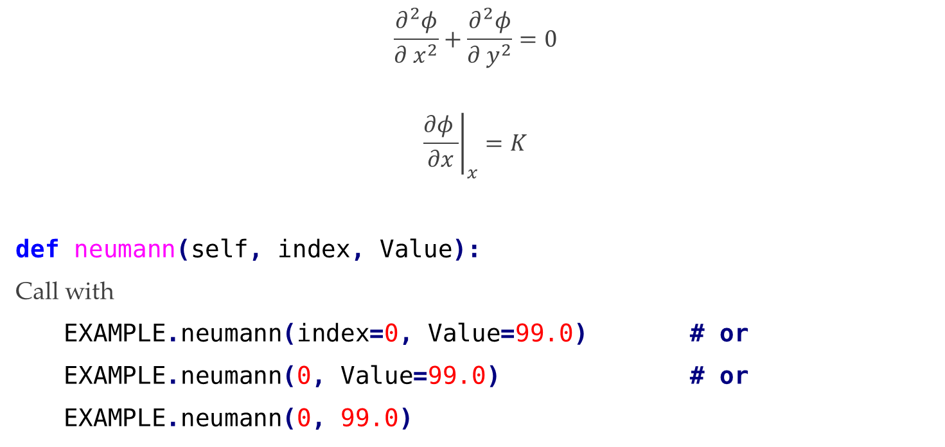
Neumann BC
$$\frac{∂^{2}φ}{∂ x^{2}}+\frac{∂^{2}φ}{∂ y^{2}}=0$$
$${\left.\frac{∂φ }{∂x}\right|}_{x}=K$$
def neumann(self, index, Value):
Call with
EXAMPLE.neumann(index=0, Value=99.0) # or
EXAMPLE.neumann(0, Value=99.0) # or
EXAMPLE.neumann(0, 99.0)

Slide 15

Which Boundary Conditions Implemented in 1D Heat Equation
Steady State 1D Heat Equation
$$\frac{∂^{2}T}{∂ x^{2}}=\frac{\dot{q}}{k}$$

Slide 16

Symmetry-Adiabatic / Constant Heat Flow
$$\frac{∂^{2}T}{∂ x^{2}}=\frac{\dot{q}}{k}$$
$${\left.\frac{∂T }{∂x}\right|}_{x}=K$$
If K=0 symmetry or adiabatic line.
K>0 Fixed heat flow enters the Control Volume
K<0 Fixed heat flow leaves the Control Volume

Slide 17
Symmetry / Constant Heat Flow
def Conduction(self, x, k):
Call with
EXAMPLE.Conduction(x=0.0, k=-10.)
I don’t know why I named this method as ‘Conduction’ ☺
Future correct forms would be
def Symetry(self, x, k=0): #and
def FixedHeatFlow(self, x, k):
Heat1d.Conduction method calls Laplace1d.Neumann method

Slide 18

Convection
$$−k\frac{∂T}{∂x}=h\left(T−T_{ambient}\right)$$
def Convection(self, x, k, h, Ta):
Call with:
EXAMPLE.Convection(x=1.0, k=75., h=125.0,Ta=200.0)

Slide 19
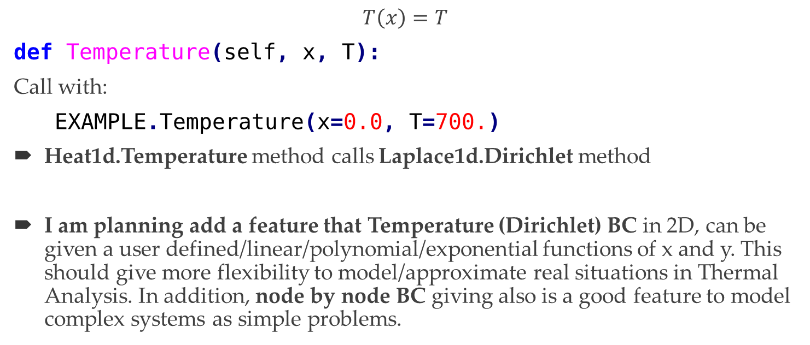
Fixed Temperature
$$T\left(x\right)=T$$
def Temperature(self, x, T):
Call with:
EXAMPLE.Temperature(x=0.0, T=700.)
Heat1d.Temperature method calls Laplace1d.Dirichlet method
I am planning add a feature that Temperature (Dirichlet) BC in 2D, can be given a user defined/linear/polynomial/exponential functions of x and y. This should give more flexibility to model/approximate real situations in Thermal Analysis. In addition, node by node BC giving also is a good feature to model complex systems as simple problems.

Slide 20
Source
An now, source method supposes that, heat generation is uniform and all elements generates heat. A feature must be added in 2D such that a source can be given a few nodes. It is more realistic than now.
EXAMPLE.source(k=WATER_K, Q=7.5e4)

Slide 21
A simple Example
from pytotube import Heat1d
Q = Heat1d(L=1.0, N=5)
WATER_K = 70.
Q.source(k=WATER_K, Q=7.5e4)
Q.Conduction(x=0.0, k=0.)
Q.Convection(x=1.0, k=WATER_K, h=500., Ta=300.)
Q.solve()
Q.plot()
Q.ax.set(title=r'Temperature Distribution')

Slide 22
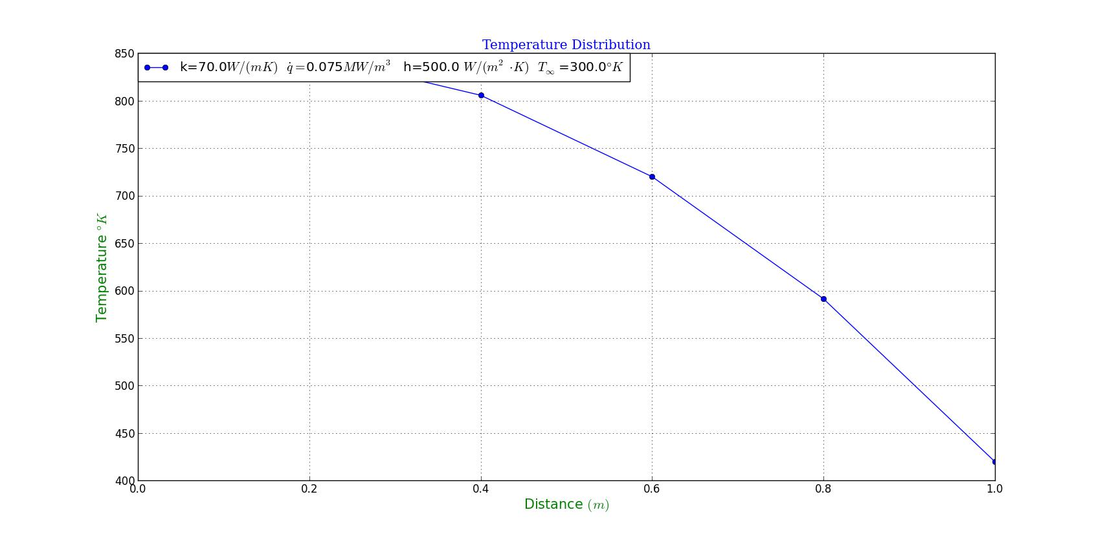
A simple Example

Slide 23
A simple Example
>>> Q.A
array([[ 1., -1., 0., 0., 0., 0.],
[ 1., -2., 1., 0., 0., 0.],
[ 0., 1., -2., 1., 0., 0.],
[ 0., 0., 1., -2., 1., 0.],
[ 0., 0., 0., 1., -2., 1.],
[ 0., 0., 0., 0., 70., -170.]])
>>> Q.B
array([[ 0. ],
[ -42.85714286],
[ -42.85714286],
[ -42.85714286],
[ -42.85714286],
[-30000. ]])

Slide 24
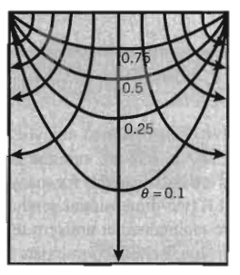


Analogy with Heat Transfer and Irrotational Flow
2d Potential Flow
2d Heat Transfer
$$\frac{∂^{2}φ}{∂ x^{2}}+\frac{∂^{2}φ}{∂ y^{2}}$$
$$\frac{∂φ}{∂x}=u$$
$$\frac{∂φ}{∂y}=v$$
$$\frac{∂^{2}T}{∂ x^{2}}+\frac{∂^{2}T}{∂ y^{2}}=0$$
Convection Heat Transfer
$$q_{x}=−kA\frac{∂T}{∂x}$$
$$q_{y}=−kA\frac{∂T}{∂y}$$

Slide 25

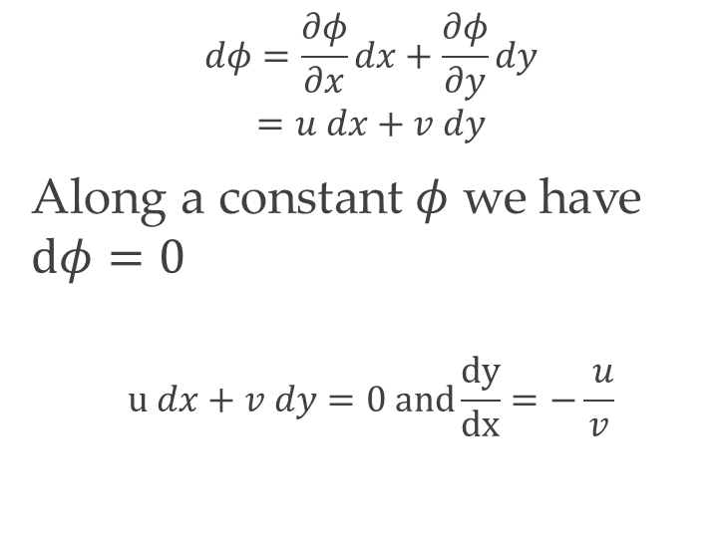
Analogy with Heat Transfer and Irrotational Flow
2d Potential Flow
2d Heat Transfer
$$dφ=\frac{∂φ}{∂x}dx+\frac{∂φ}{∂y}dy$$
$$=u dx+v dy$$
Along a constant$φ$ we have $dφ=0$
$$u dx+v dy=0 and\frac{dy}{dx}=−\frac{ u}{v}$$
This is similar to isothermal contour lines, and conservation of energy.
$$q_{x} dx+q_{y} dy=0$$

Slide 26
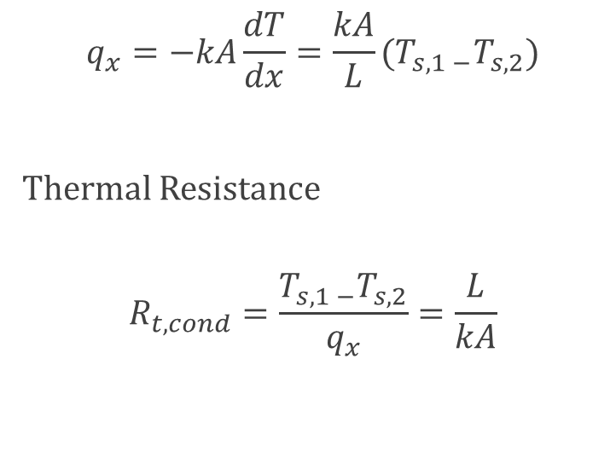

Analogy with Heat Transfer and Irrotational Flow
2d Potential Flow
2d Heat Transfer
These equations seems like $\frac{∂p}{∂x}≅\frac{Δp}{ℓ}$
$$q_{x}=−kA\frac{dT}{dx}=\frac{kA}{L}(T_{s,1 −}T_{s,2})$$
Thermal Resistance
$$R_{t,cond}=\frac{T_{s,1 −}T_{s,2}}{q_{x}}=\frac{L}{kA}$$

Slide 27
Roadmap to Dual Physics
Solving simultaneously heat transfer and fluid flow

Slide 28
Method
Conservation of mass
Conservation of Energy
Conservation of Linear Momentum

Slide 29

Conservation of mass
$$\frac{∂}{∂t}\int_{cv}^{ }{ρd𝒱}≈\frac{∂ρ}{∂t}δxδyδz$$
$$\frac{∂ρ}{∂t}+\frac{∂(ρu)}{∂x}+\frac{∂(ρv)}{∂y}+\frac{∂(ρw)}{∂z}=0$$
$$\frac{∂ρ}{∂t}+∇⋅ρ\vec{V}=0$$

Slide 30
Conservation of Energy (Energy Equation)

Slide 31
Conservation of Linear Momentum

Slide 32
Comments and Recommendations
Laplace1d and Heat1d was only simple trial of solving Laplace equation with Finite Differences.
And experimenting the difficulties developing a general use solver and algorithms with Python/Numpy.
And picking a numerical scheme, numerical method, building a small application structure and drawing a roadmap for PDE solving.
And comparing different approaches with engineering and numerical problems
Energy Approach / Finite Differences
Node based / Cell Based
2D solver is serious work because, 2D PDE result are more meaningful than 1D, and often more than 3D analysis.

Slide 33
Comments and Recommendations
To sum up, all of these works in 1D are only a meeting with:
Numpy/Optimization Tools
Numerical methods/schemes
PDE solving Finite Elements/Volumes/Differences
Problem solving and developing algorithm
Developing a tested and documented scientific application with a software engineer approach.

Slide 34
2D Laplace Equation
X
(1,1)
(1,2)
(1,3)
(1,4)
…
(1,NX)
…
…
…
…
…
(2,NX)
(NY,1)
(NY,2)
(NY,3)
(NY,4)
(NY,NX-1)
(NY,NX)
Y

Slide 35
Indexing
X
0
1
2
3
…
NX-1
NX
…
I × NX + J
…
…
2 × NX-1
(NY-1)×NX
…
…
…
…
NY × NX-1
Y

